Slide 1

Generative Adversarial Networks
Presented by Steven Kundert and Shenglin Sun

Slide 2
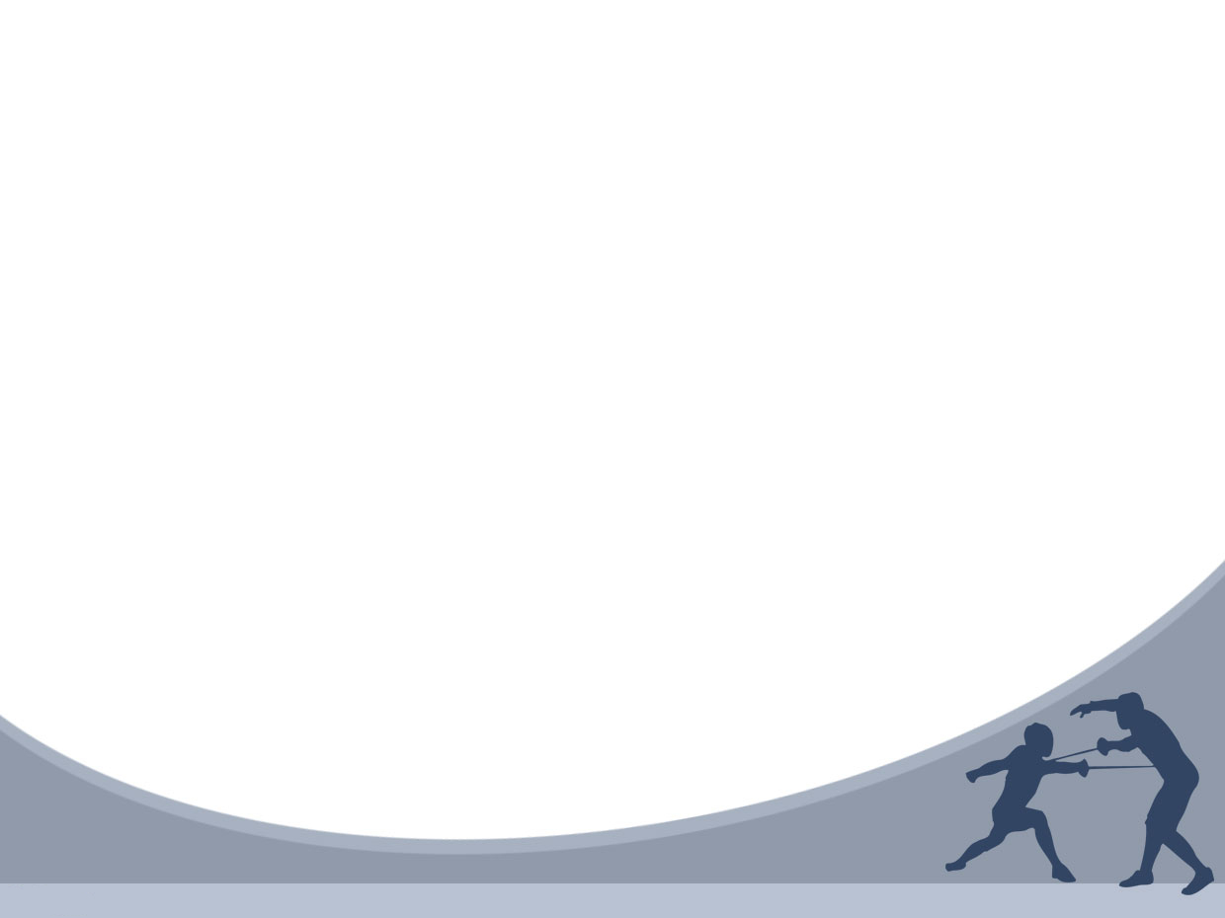
Outline
Introduction
Generative Adversarial Networks
Example
Training the Models
Experiment
Advantages and Disadvantages
Why It’s Important

Slide 3
Introduction
Deep learning has been used to model artificial intelligence
Most successful deep learning involves discriminative models that map input into class labels
Based on back-propagation and dropout algorithms using weight and bias vectors with well-behaved gradients

Slide 4
Introduction
Deep generative models have had less success
Difficult to leverage usefulness of weight and bias vectors
In an adversarial net, a generative model is pitted against an discriminative model that learns to tell whether a sample is real or fake

Slide 5
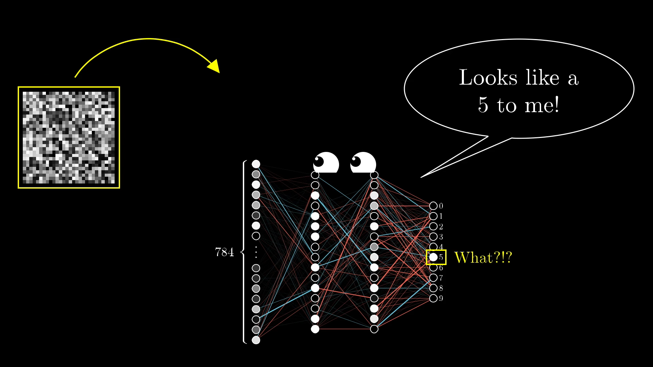
What happens when random data is input into the discriminative model?
The model thinks that the random data fits into the class ‘5’

Slide 6
Introduction
Consider a trained CNN that works well on ImageNet data
Take a sample image and manipulate it so that the prediction error is maximized
The predicted classification of the image will change, while the image looks similar to the original
An adversarial image is one that will fool a CNN

Slide 7
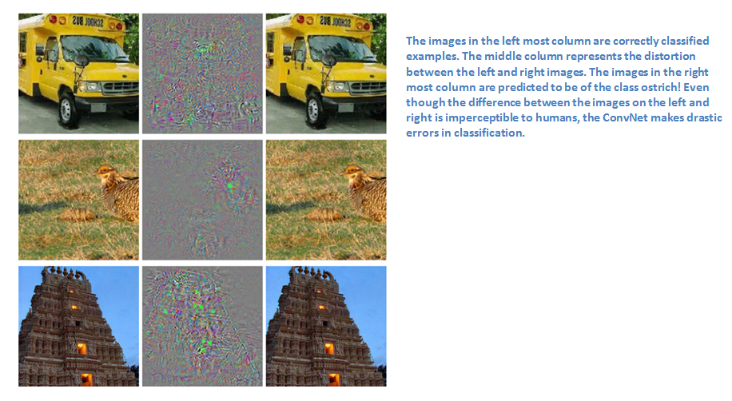

Slide 8
Generative Adversarial Networks
Create a generative model that generates samples by passing random noise through a multilayer perceptron
Create a discriminative model that is also a multilayer perceptron
Train both models using back-propagation and dropout algorithms
Sample from the generative model using forward propagation

Slide 9

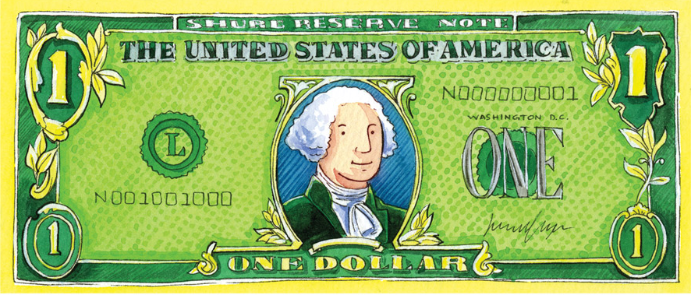
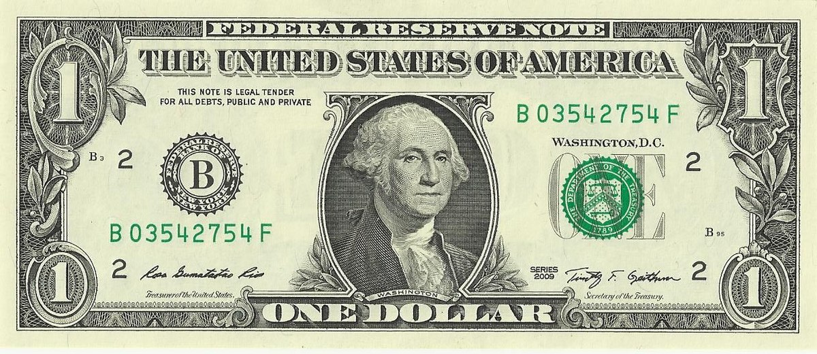

Example
Generative model acts like a currency counterfeiter
Discriminative model acts like police trying to catch counterfeits
Competition drives both to improve their methods until counterfeit is identical to real thing

Slide 10
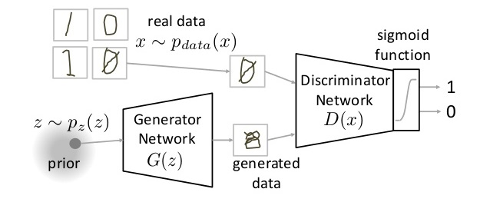
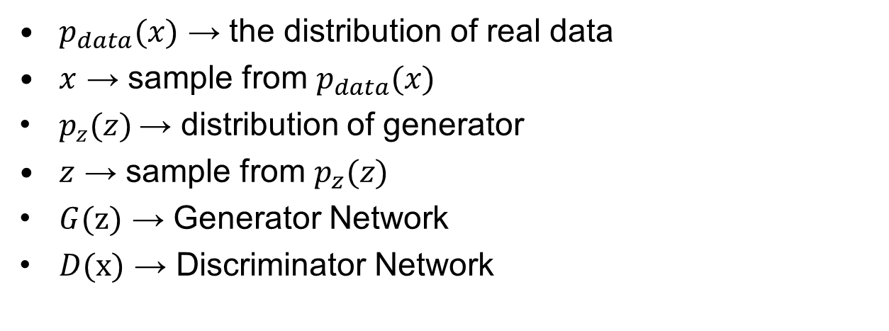
GAN Model
$p_{data}(x)$ → the distribution of real data
$x$ → sample from $p_{data}(x)$
$p_{z}(z)$→ distribution of generator
$z$ → sample from $p_{z}(z)$
$G$(z) → Generator Network
$D$(x) → Discriminator Network

Slide 11
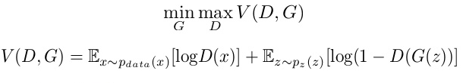

Training the Models
Train $D$ to maximize probability of assigning the correct label to both training samples and samples from $G$
Train $G$ to minimize detection by $D$

Slide 12
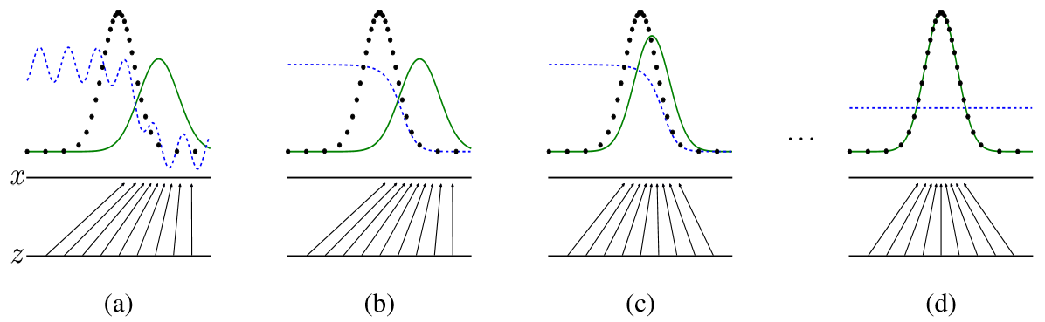

Training the Models
Optimize $D$ (without training $G$) to predict real data as real
Create fake data with $G$ and train $D$ to predict them as fake
Use predictions from $D$ to train $G$ to fool $D$
Repeat steps 1-3 for several epochs
Stop once generated data converges to real data

Slide 13
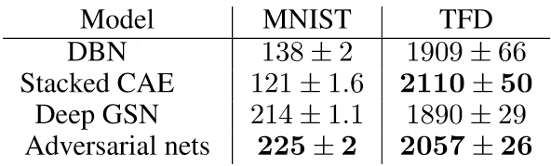
Experiment
Trained GAN on several datasets
MNIST
Toronto Face Database (TFD)
CIFAR-10
Compared to other generative models such as deep belief networks and deep stochastic networks, the adversarial net demonstrated higher probability of matching the data

Slide 14
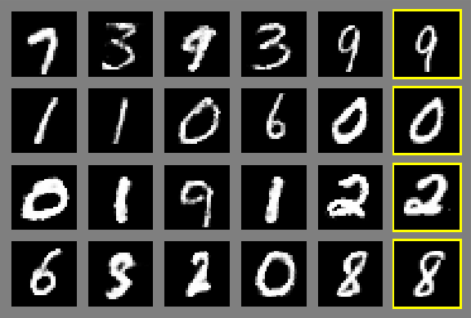
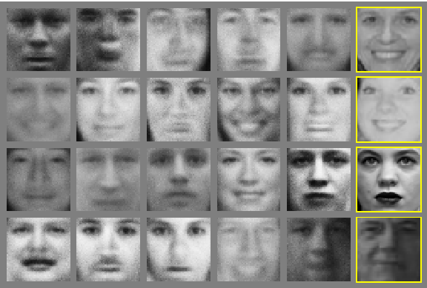
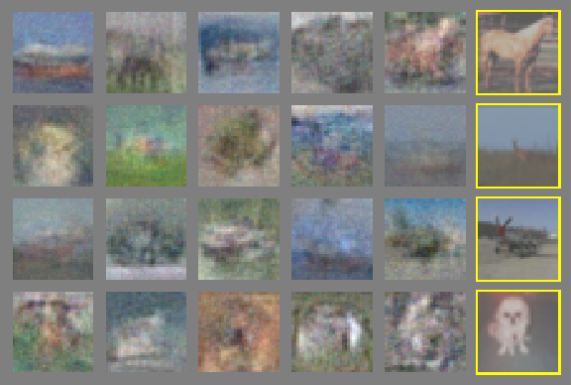
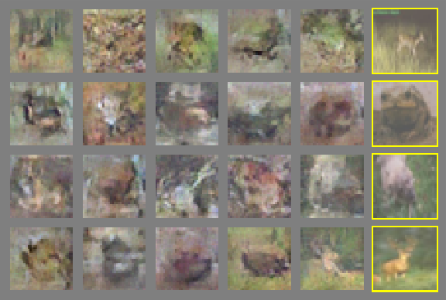
a) b)
c) d)
Right columns show nearest match in training data to neighboring images. These are generated, not a memorization of the training data.
a) MNIST, b) TFD, c) CIFAR-10, d)CIFAR-10

Slide 15
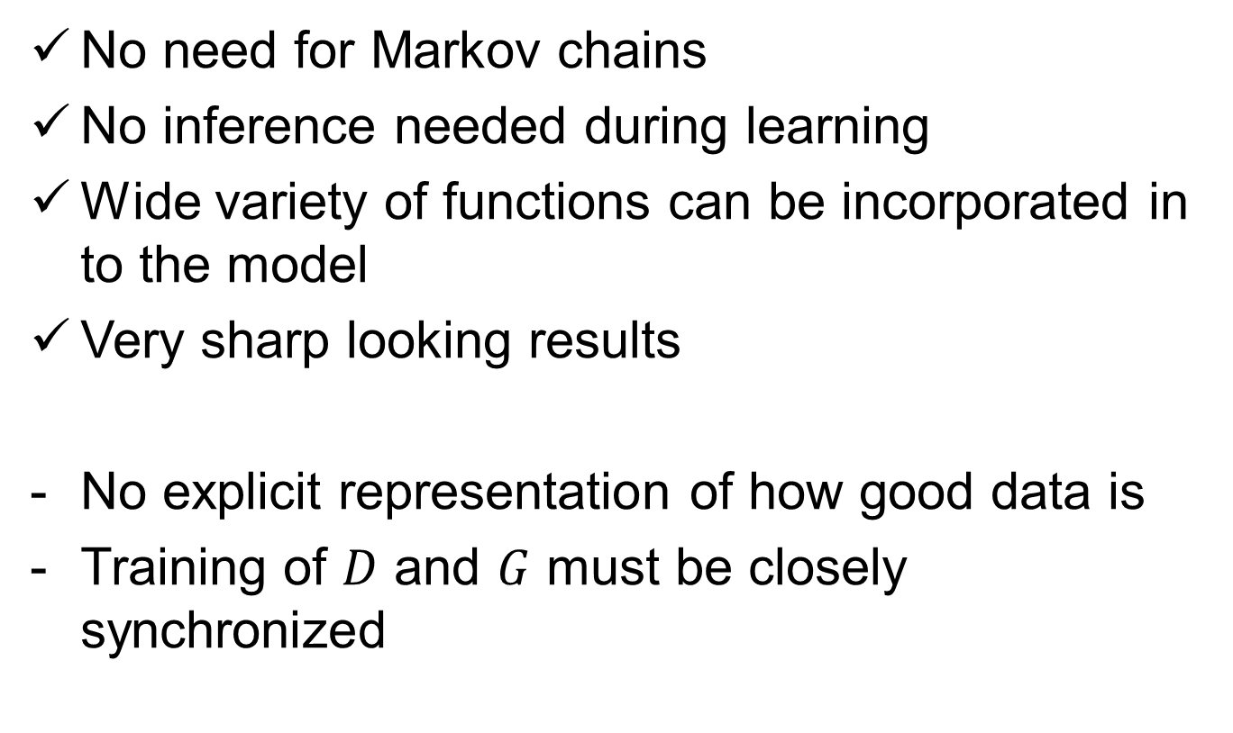
Advantages and Disadvantages
No need for Markov chains
No inference needed during learning
Wide variety of functions can be incorporated in to the model
Very sharp looking results
No explicit representation of how good data is
Training of $D$ and $G$ must be closely synchronized

Slide 16
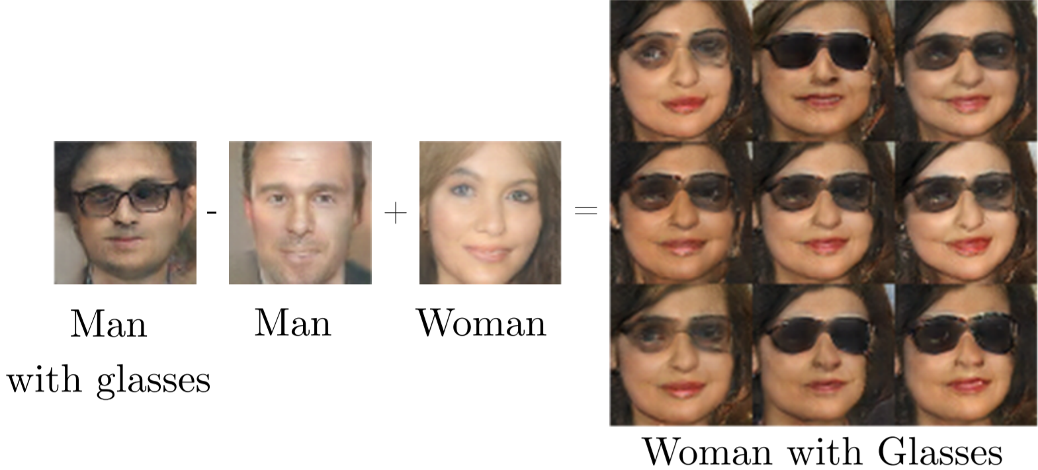
Why It’s Important
No longer get “false positive” from the discriminative model when fed random noise
Model has learned that not everything fits into the real data distribution
Can be used as a feature extractor
Can predict future (such as next frame in a video)

Slide 17
Questions?

